Slide 1
Assignment:
EEG-Based Stress Recognition Using Neural Networks

Slide 2
Summary
Dataset presentation
Data analysis
Cleaning data processes
Stress Recognition Models
Evaluation and results analysis
Model optimization
Conclusion

Slide 3
Dataset presentation

Slide 4
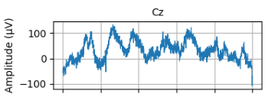
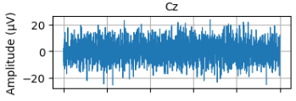
1. Dataset presentation
EEG data :
40 subjects
Recorded during 3 differents tasks and during relax state
3 trials for each task for each subject (duration of a task trial : 25s)
32 electrodes on the subject’s head -> 32 EEG of 3200 time points for each record
Each task has a :
Raw version
Filtered version
(with given Matlab code)
Subject 1, during arithmetic task trial 1, Cz electrode raw (left) and filtered (right)

Slide 5
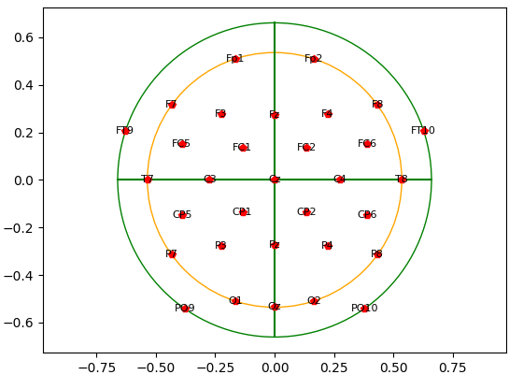
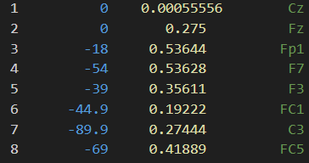
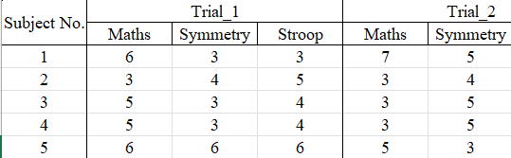
1. Dataset presentation
Polar coordinates of the electrodes :
Subject’s feelings about their stress :
On a 1-10 scale
For each trial and each task
(not relax stress because no stress)
Subject’s head, top view, nose on the top of the picture, with electrodes in place

Slide 6
Data exploration

Slide 7
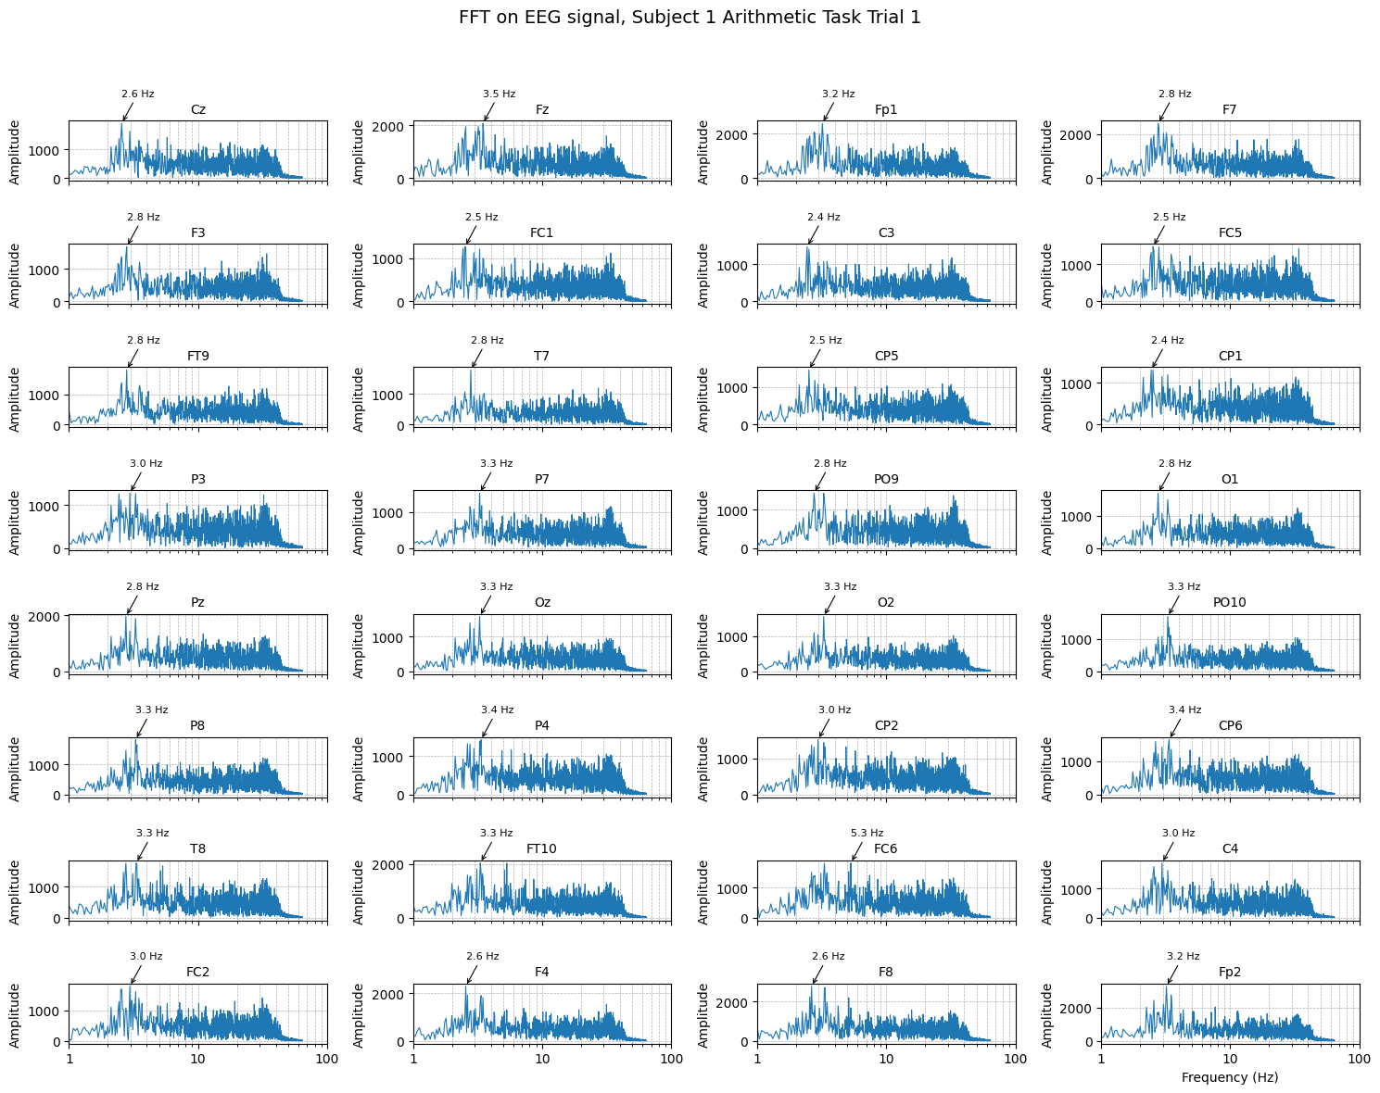
2. Data exploration
Fourier transform on each channel with peak frequency detection (on filtered data):

Slide 8
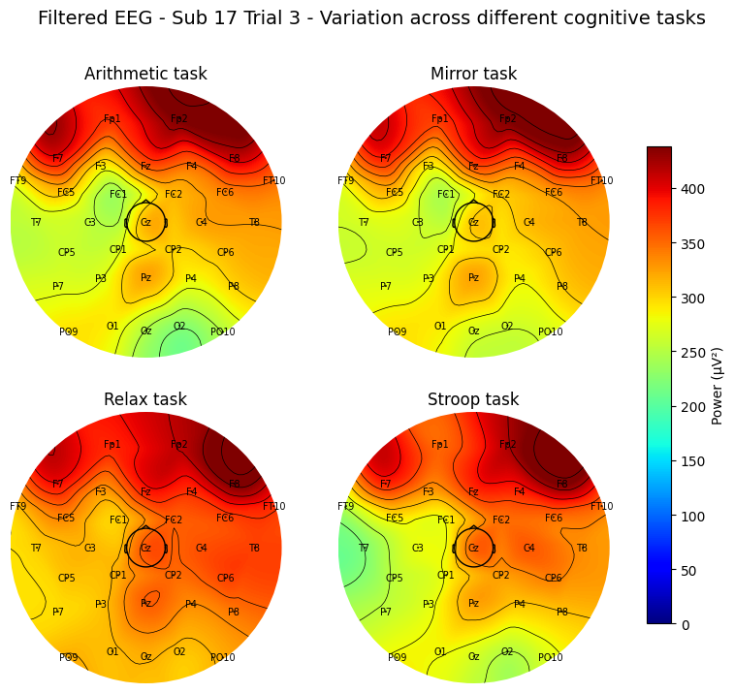
2. Data exploration
Topographic map of the mean of the power of the EEG :
Third trial of each task for subject 17 (on filtered data)

Slide 9
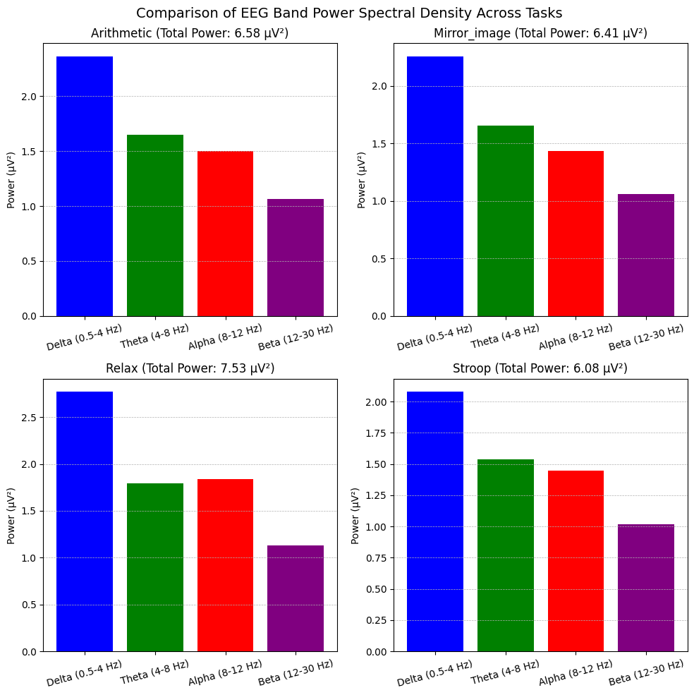
2. Data exploration
Power repartition on the bands for each task
Beta (β) 12–30 Hz
Alpha (α) 8–12 Hz
Theta (θ) 4–8 Hz
Delta (δ) 0.5–4 Hz

Slide 10
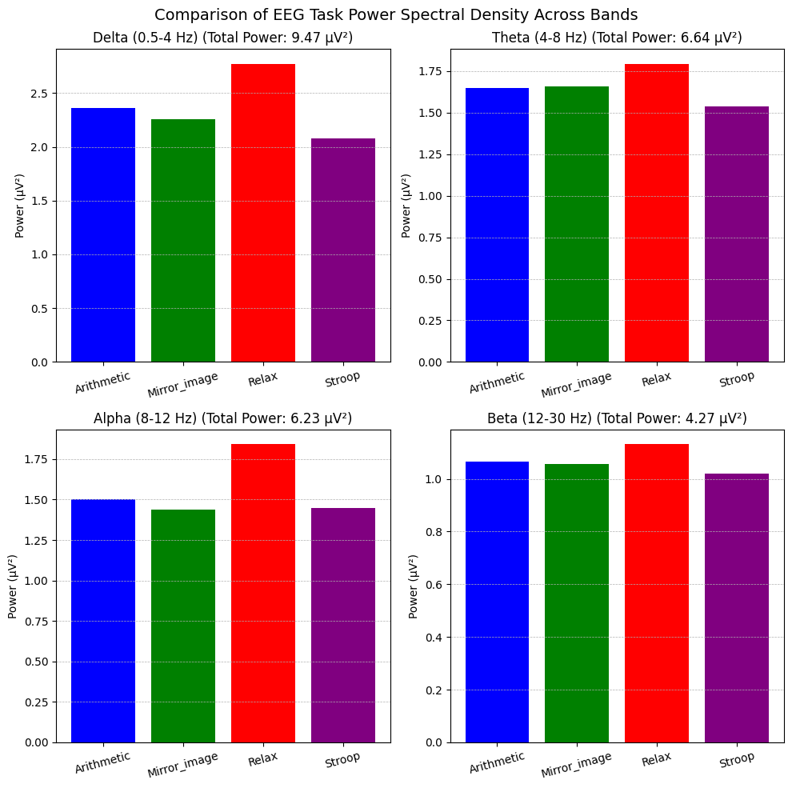
2. Data exploration
Power repartition on the tasks for each band
Beta (β) 12–30 Hz
Alpha (α) 8–12 Hz
Theta (θ) 4–8 Hz
Delta (δ) 0.5–4 Hz

Slide 11
Cleaning data process

Slide 12
3. Cleaning data processes
Wavelet_denoising()
Purpose: Remove noise from EEG by thresholding high-frequency components while preserving signal features.
How it works:
Decomposes the signal into levels of approximation (low frequencies) and detail (high frequencies) coefficients using a chosen wavelet (e.g., Daubechies 4).
Noise Estimation: Estimates noise based on the median absolute deviation of the smallest (noisiest) coefficients.
Adaptive Thresholding: Applies soft thresholding to suppress coefficients below the threshold, which mainly represent noise.
Reconstruction: Rebuilds the signal from the thresholded coefficients.
Why use it? To target transient artifacts like muscle movements or electrical noise that appear in specific frequency bands.

Slide 13
3. Cleaning data processes
SKLFast_ICA()
Purpose: A standalone ICA-based cleaning algorithm focusing on strong artifact rejection.
How it works:
Bandpass Filtering: Prepares the data by filtering before ICA.
FastICA: Decomposes the EEG into independent components.
Artifact Detection: Detects components with unusually large amplitudes, assuming they represent artifacts. Uses a threshold lambda times the median absolute deviation to flag components.
Artifact Removal: Zeros out the detected artifact components.
Reconstruction: Applies the inverse ICA to rebuild the cleaned EEG signal without the artifacts.
Why use it? To directly identify and suppress components with large, artifact-like activity using a simple, amplitude-based rule.

Slide 14
3. Cleaning data processes
matlab_like_cleaning()
Purpose: Reproduce the original MATLAB algorithm using Python methods.
How it works:
Savitzky-Golay Filtering: Applies a polynomial smoothing filter to estimate and subtract slow trends (like drifts or baseline wander).
Wavelet Thresholding: Decomposes the detrended signal into wavelet levels. Uses a fixed threshold (based on the standard deviation of certain detail coefficients) to suppress artifacts. Applies hard clipping to limit extreme values.
Reconstruction: Reconstructs the cleaned signal from the thresholded coefficients
Why use it? It's a simpler, heuristic-based method that works decently for suppressing strong artifacts without requiring complex spatial decomposition like ICA.

Slide 15
3. Cleaning data processes
modern_cleaning()
Purpose: Combine multiple advanced methods into a full cleaning pipeline.
How it works:
Bandpass Filtering (1-40 Hz): Remove slow drifts and high-frequency noise.
ICA (Independent Component Analysis): Decomposes multi-channel EEG into independent components. Allows for manual or automatic rejection of components associated with artifacts (e.g., eye blinks, muscle noise).
In this case, automatic rejection is commented out, but manual exclusion is possible after visualization.
Wavelet Denoising (on each channel): Further removes fine-scale noise after ICA, handling remaining high-frequency noise.
Why use it? To combine the strength of spatial decomposition (ICA) and temporal denoising (wavelets) for a robust cleaning.

Slide 16
3. Cleaning data processes
Algorithm | Focus | Strength | Weakness
wavelet_denoising | Temporal noise (per channel) | Great for high-frequency noise | May not handle spatial artifacts
SKLFast_ICA | Strong artifact removal | Automatic ICA-based artifact rejection | May remove too much or too little depending on lambda chosen
modern_cleaning | Full pipeline | Combines ICA + wavelets | Needs manual tuning for ICA
matlab_like_cleaning | Trend + noise removal | Simple and interpretable | Less adaptive, fixed thresholds

Slide 17
Stress recognition models

Slide 18
4. Stress recognition models
1) SimpleNN
A basic fully connected feedforward network for EEG classification.
Architecture:
Input: Flattened EEG data (num_channels × num_timepoints).
Layers:
fc1: Fully connected layer (input → 128 neurons).
fc2: Fully connected layer (128 → 64 neurons).
fc3: Output layer (64 → num_classes neurons).
Activations: ReLU after fc1 and fc2.
Output: Raw logits for classification.
Purpose: A simple baseline model, quick to train, but limited in capturing spatial-temporal features of EEG signals.

Slide 19
4. Stress recognition models
2) EEG_CNN
A 1D Convolutional Neural Network (CNN) designed to extract features across time for each EEG channel.
Architecture:
Convolutions:
conv1: 64 filters, kernel size 7.
conv2: 128 filters, kernel size 5.
conv3: 256 filters, kernel size 3.
Batch Normalization after each convolution.
MaxPooling to reduce dimensionality (pool size 2).
Fully connected:
fc1: 128 neurons.
fc2: Output layer (num_classes neurons).
Activations: ReLU.
Output: Raw logits.
Purpose:Captures temporal patterns and local dependencies in the EEG signal, channel-wise.

Slide 20
Evaluation and results analysis

Slide 21
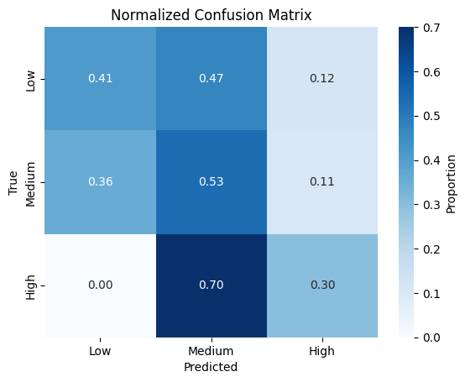
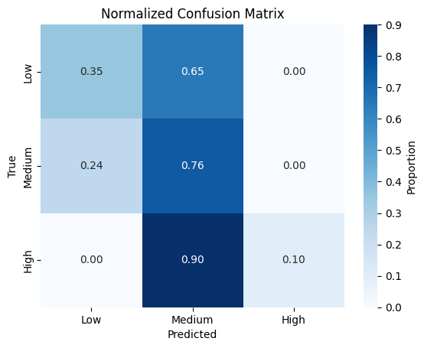
5. Evaluation and results analysis
SimpleNN
Weighted F1-score: 0.4814
Accuracy: 47.22%
EEG_CNN
Weighted F1-score: 0.5379
Accuracy: 56.94%

Slide 22
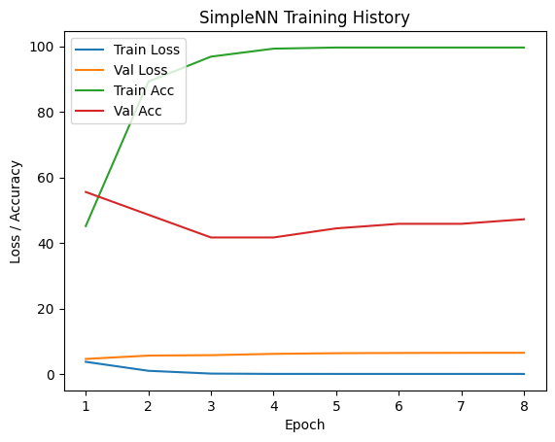
5. Evaluation and results analysis
SimpleNN
Weighted F1-score: 0.4814
Accuracy: 47.22%
EEG_CNN
Weighted F1-score: 0.5379
Accuracy: 56.94%

Slide 23
5. Evaluation and results analysis
SimpleNN and EEG_CNN give nearly aleatory Confusion Matrixes (after Softmax to compare well), but not anti-diagonal ones. They overfit on train set
Regarding Confusion Matrixes, SimpleNN seems to be the more accurate model

Slide 24
5. Evaluation and results analysis
Main problem is the overfitting on the training set
Solutions :
Regularization : add dropout and batchnorm sub-layers in convolution layers.
Likewise SimpleNN2 and EEG_CNN2
Over-sampling
Under-sampling
Weighted loss function

Slide 25
Model optimization

Slide 26
6. Model optimization : Regularization
1) SimpleNN2
An improved version of SimpleNN with:
Batch Normalization.
Dropout for regularization.
Smaller layers for faster computation.
Architecture:
fc1: 64 neurons + BatchNorm + Dropout(0.4).
fc2: 32 neurons + BatchNorm + Dropout(0.4).
fc3: Output layer (num_classes neurons).
ReLU activations.
Purpose:Same as SimpleNN, but with added regularization to reduce overfitting.

Slide 27
6. Model optimization : Regularization
2) EEG_CNN2
A lighter CNN variant with:
Fewer filters: 32 and 64.
Two convolutional layers instead of three.
More Dropout for regularization.
Architecture:
conv1: 32 filters.
conv2: 64 filters.
Dropout after conv layers.
fc1: 64 neurons + Dropout(0.4).
fc2: Output layer (num_classes neurons).
Purpose: Faster, more regularized CNN with reduced risk of overfitting on smaller datasets.

Slide 28
6. Model optimization : Regularization
3) EEG_CNN_GRU
A hybrid model combining CNN and GRU (Gated Recurrent Unit): CNN extracts spatial and local features.
GRU captures sequential temporal dependencies.
Architecture:
CNN part:
conv1: 64 filters.
MaxPooling(2), Dropout(0.3).
GRU part:
64 hidden units, processing sequences of feature vectors.
Fully connected:
fc1: 32 neurons + Dropout(0.4).
fc2: Output layer (num_classes neurons).
Purpose: Perfect for EEG where you want to capture both Local time-based patterns (CNN) and global sequential trends (GRU).

Slide 29
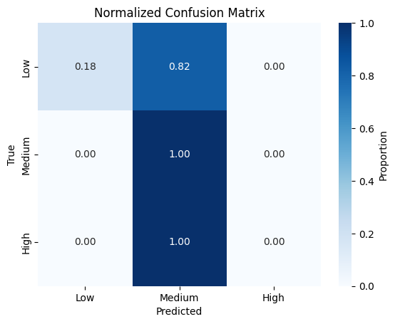
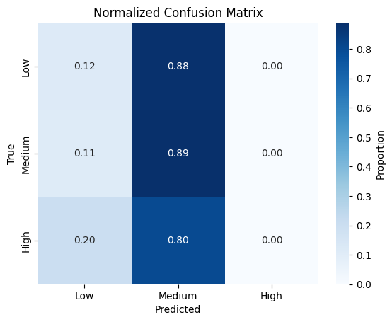
6. Model optimization : Regularization
SimpleNN2
Weighted F1-score: 0.5643
Accuracy: 66.67%
EEG_CNN2
Weighted F1-score: 0.4993
Accuracy: 58.33

Slide 30
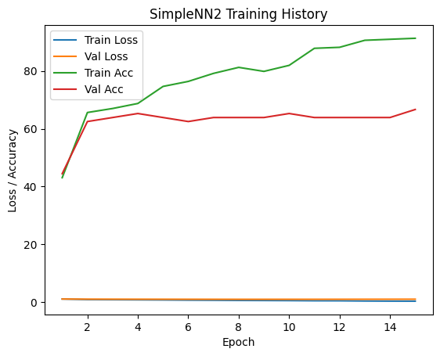
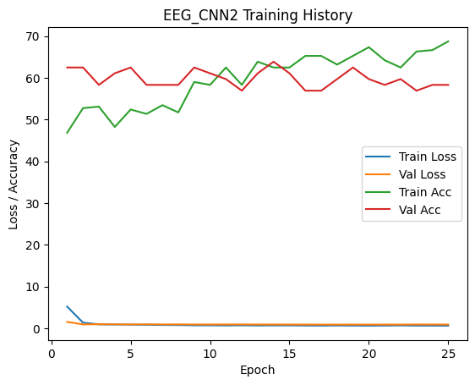
6. Model optimization : Regularization
SimpleNN2
Weighted F1-score: 0.5643
Accuracy: 66.67%
EEG_CNN2
Weighted F1-score: 0.4993
Accuracy: 58.33

Slide 31
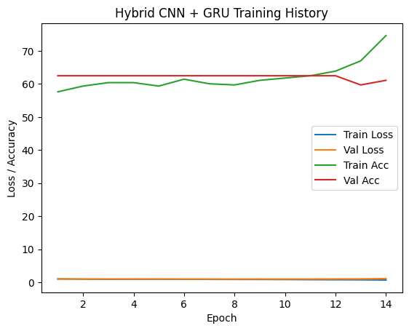
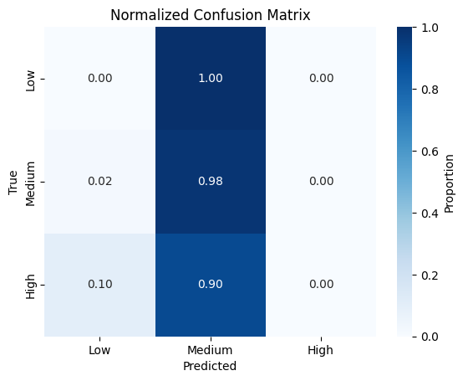
6. Model optimization : Regularization
HybridCNN + GRU
Weighted F1-score: 0.4783
Accuracy: 61.11%

Slide 32
6. Model optimization : Regularization
Model | Strength | When to use ?
SimpleNN | Fast, simple baseline | Quick tests, small satasets
EEG_CNN | Good temporal feature extraction | Medium datasets, stronger features
SimpleNN2 | Regularized, lightweight | Likewise SimpleNN but with regularization
EEG_CNN2 | Faster, more regularized CNN | Likewise EEG_CNN, overfitting risk
EEG_CNN_GRU | Combines spatial + temporal learning | Complex tasks, longer EEG sequences

Slide 33
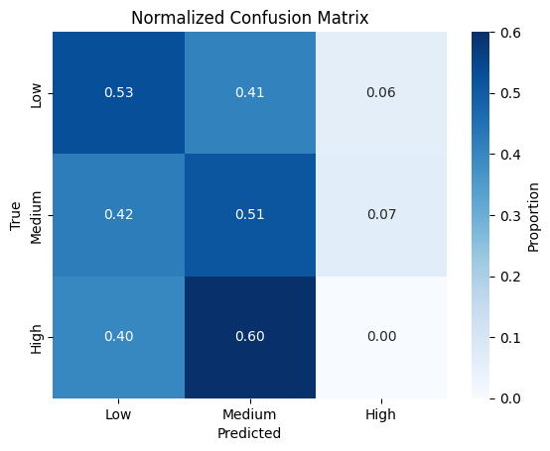
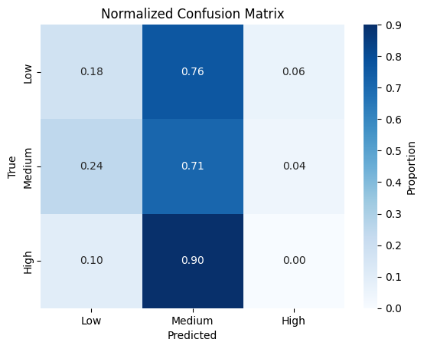
6. Model optimization : Over-Sampling
SimpleNN w. Over-Sampling
Weighted F1-score: 0.4417
Accuracy: 44.44%
EEG_CNN w. Over-Sampling
Weighted F1-score: 0.4483
Accuracy: 48.61%

Slide 34
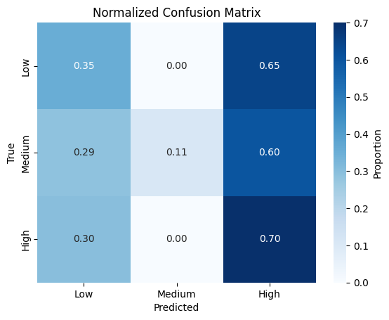
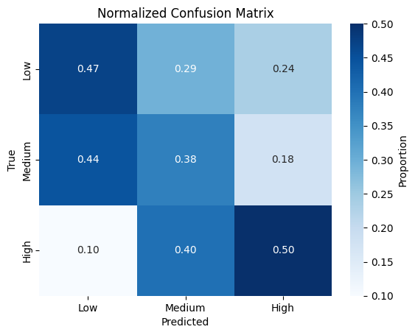
6. Model optimization : Under-Sampling
SimpleNN w. Under-Sampling
Weighted F1-score: 0.2330
Accuracy: 25.00%
EEG_CNN w. Under-Sampling
Weighted F1-score: 0.4329
Accuracy: 41.67%

Slide 35
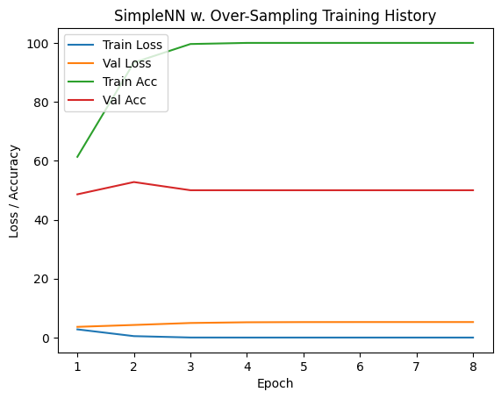
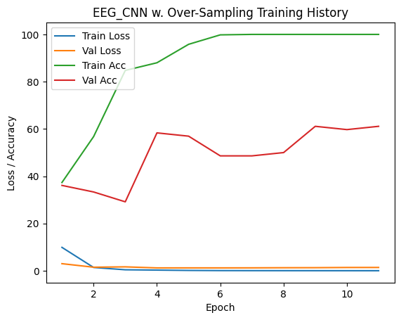
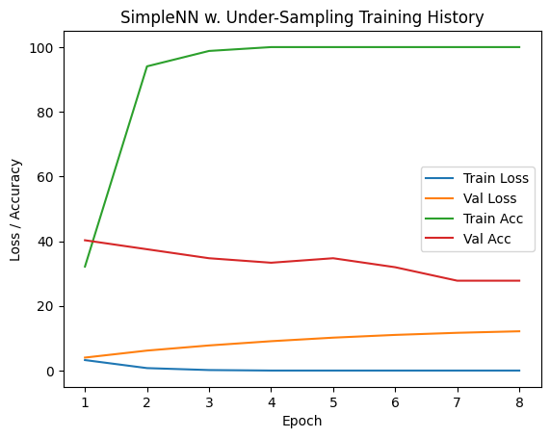
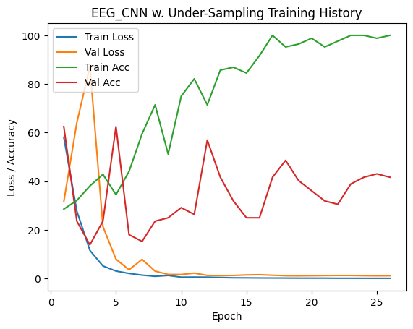
6. Model optimization : Under/Over-Sampling

Slide 36
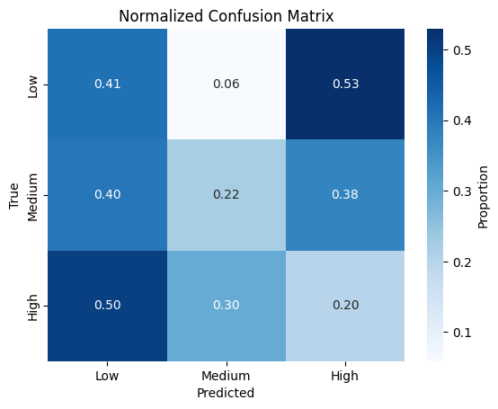
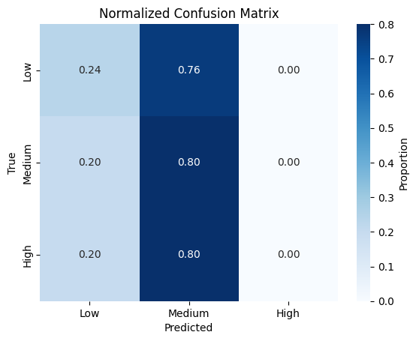
6. Model optimization : Weighted Loss F.
SimpleNN w. Weighted Loss Function
Weighted F1-score: 0.2968
Accuracy: 26.39%
EEG_CNN w. Weighted Loss Function
Weighted F1-score: 0.5002
Accuracy: 55.56%

Slide 37
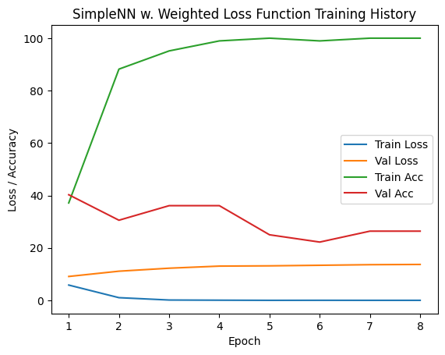
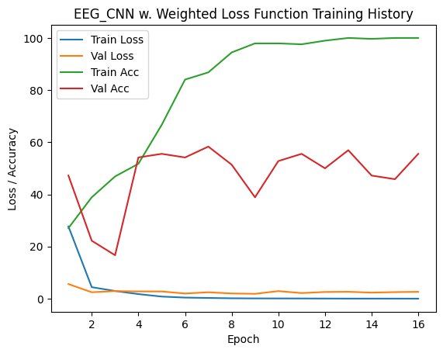
6. Model optimization : Weighted Loss F.
SimpleNN w. Weighted Loss Function
Weighted F1-score: 0.2968
Accuracy: 26.39%
EEG_CNN w. Weighted Loss Function
Weighted F1-score: 0.5002
Accuracy: 55.56%

Slide 38
Conclusion

Slide 39
5. Evaluation and results analysis
SimpleNN and EEG_CNN give nearly aleatory Confusion Matrixes (after Softmax to compare well), but not anti-diagonal ones. They overfit on train set
SimpleNN2 and EEG_CNN give better accuracy scores (not weighted), buy the confusion matrixes obtaines are not diagonal at all.
Hybrid CNN+GRU gives the worst confusion matrix too, but I don’t know how it works exactly, so I can optimize it.
Under-Sampling before using the CNN seems to be the most efficient model.

Slide 40
Conclusion
Pros :
Working filtering algorithms
Working under-sampling and over-sampling algorithms
Working load_dataset and load_labels functions
Cons :
Bad results due to:
Too small dataset : 480 32-channels EEGs
Bad distribution in the dataset : nearly Gaussian, not enough data on little and high stress levels
Really subjective labels (feeling of the subject)
No idea if the Neural Networks could perform well on another dataset

